Slide 1
What is LINUX?
LINUX is an operating system (OS)
software that communicates with hardware, allows other programs to be run
schedules tasks, allocates memory, communicates with network, security
Other OS you may be familiar with: Windows, IOS, Android, macOS
LINUX is named after its creator Linus Torvalds
Free operating system first distributed in 1991
Close relationship with UNIX

Slide 2
Basic Features
Portable − software works on different hardware in the same way
Open Source − source code is freely available, community based development project
Secure − authentication features like password protection, controlled access to files, encryption of data

Slide 3
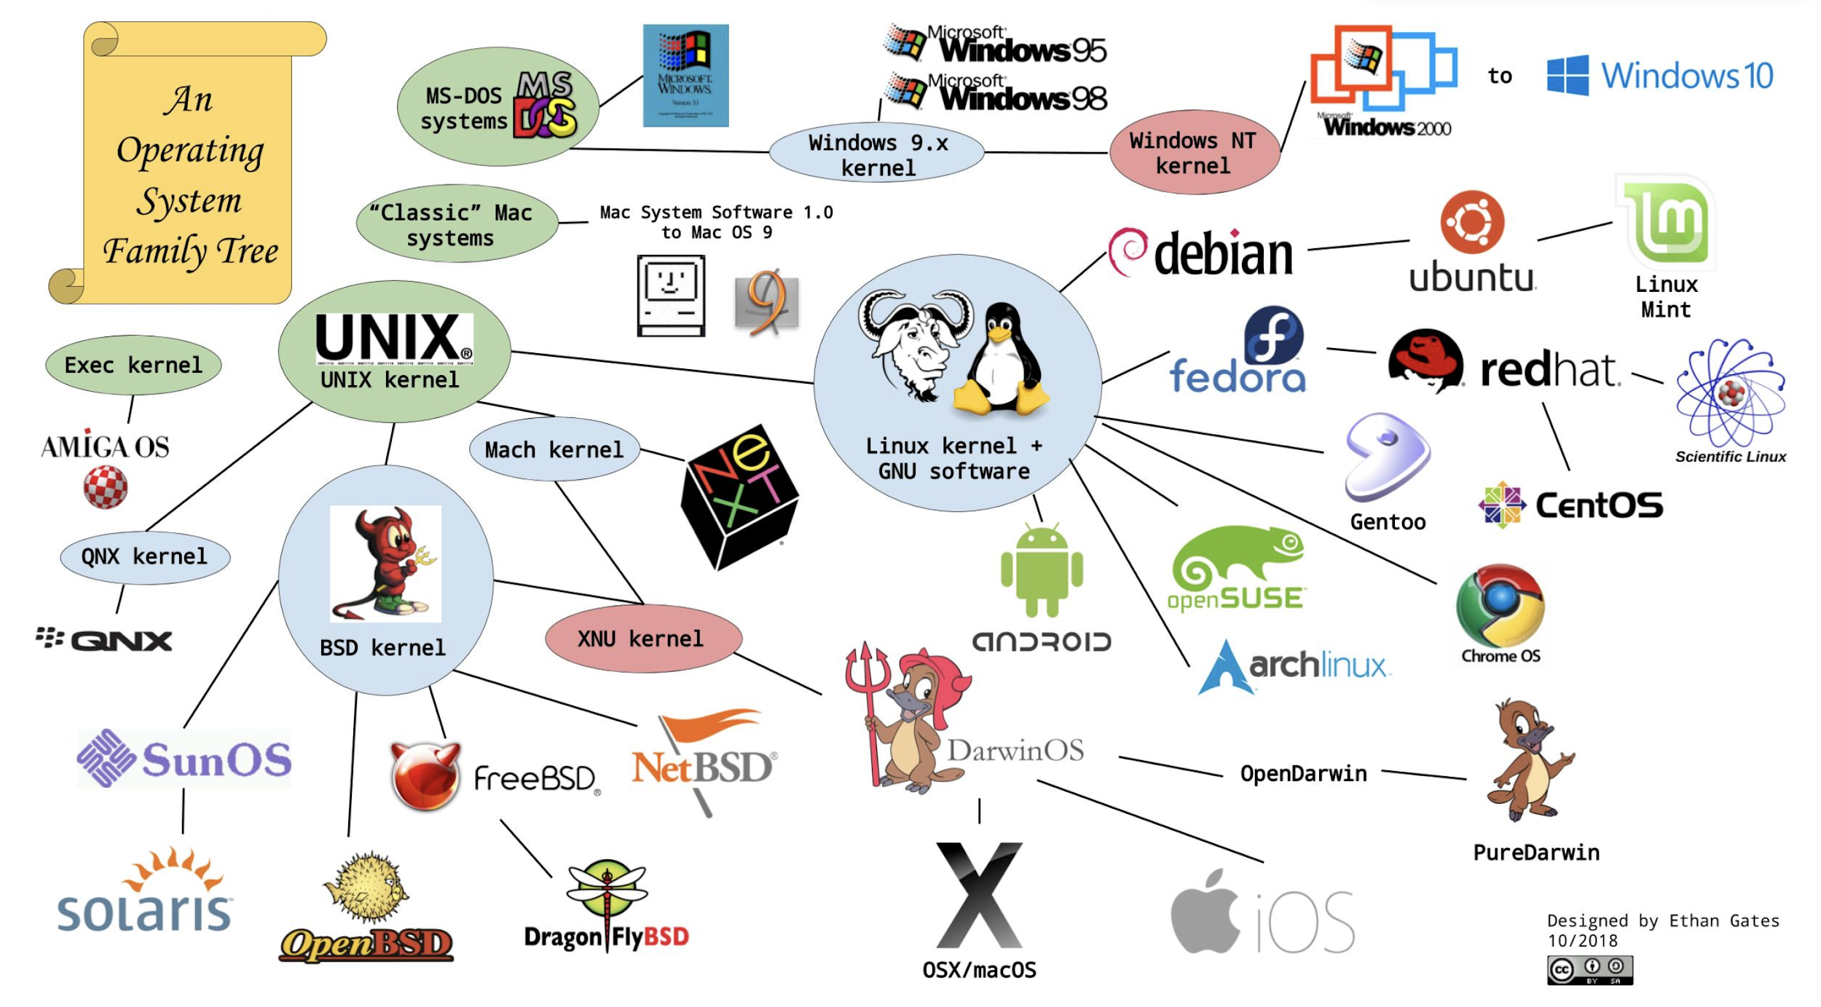

Slide 4
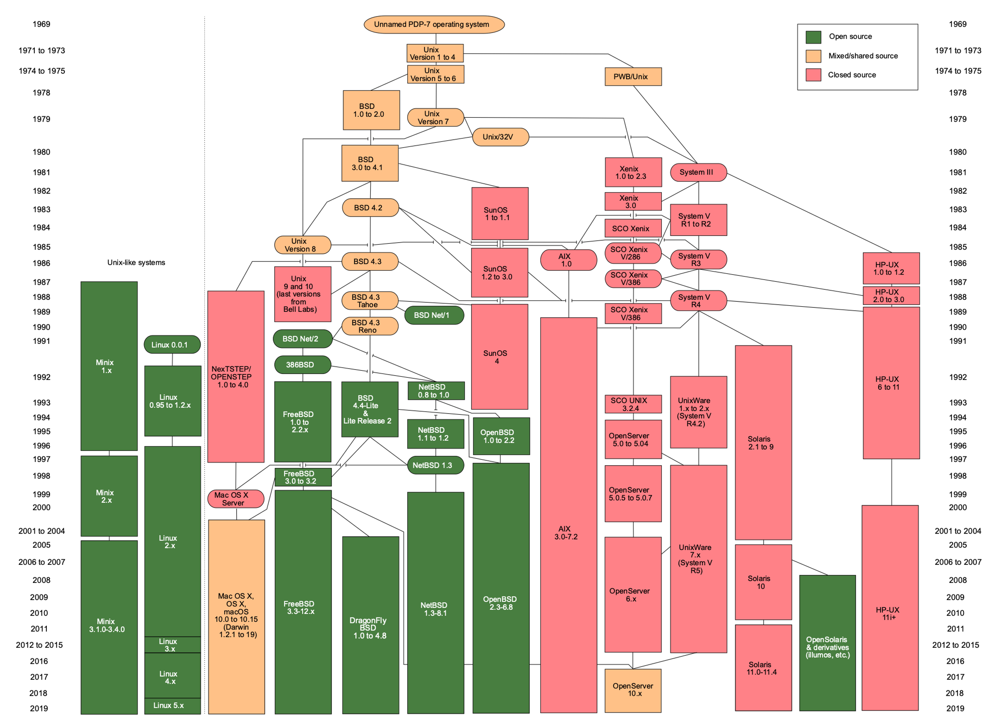
By Eraserhead1, Infinity0, Sav_vas - Levenez Unix History Diagram, Information on the history of IBM&#039;s AIX on ibm.com, CC BY-SA 3.0, https://commons.wikimedia.org/w/index.php?curid=1801948

Slide 5
Open Source
There are different “open source” licenses out there that dictate how software can be used, changed, distributed
open source software licenses promote collaboration and sharing
permit modifications to source code
people incorporate changes into their own projects
sharing is built into the philosophy
sometimes free of charge, free and open source (FOSS)
contrast with proprietary software
lack of transparency, high monetary cost

Slide 6
The Unix Philosophy
Minimalist and modular design
Write programs that do one thing and do it well.
Write programs to work together.
Write programs to handle text streams, because that is a universal interface.

Slide 7
Defining Features of UNIX/LINUX
Components:
unified filesystem
Inter-process communication mechanism known as “pipes”
Shell scripting and command language is used to combine tools to perform complex workflows

Slide 8
Pipes
Use of “|” character to pass information from one program output straight into another program…
Takes whatever is being sent to standard out (the screen) and passes it onto the next process
This is like an assembly line and can be used for an infinite number of everyday things…
Notes:
cd ls pwd PATH .. .

Slide 9
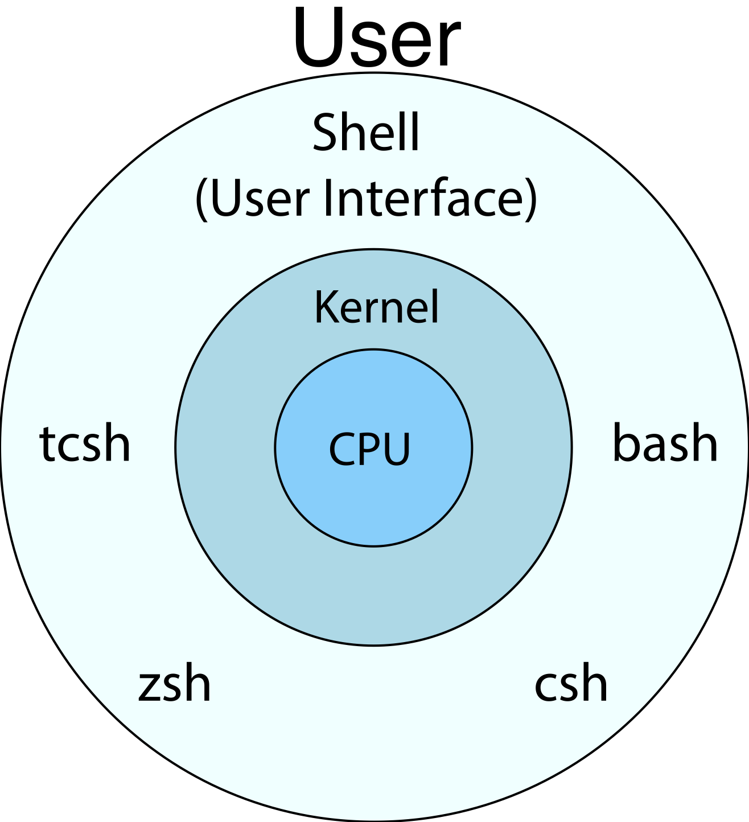

Slide 10
Architecture of the System
Hardware layer − peripheral devices (RAM/ HDD/ CPU)
Kernel − core component of Operating System, interacts directly with hardware, provides low level services to upper layer components
Shell − takes commands from the user and executes kernel's functions
Utilities − Utility programs that provide the user most of the functionalities of an operating systems

Slide 11
User Interface Options
command line interface (CLI)
directly typing commands and viewing text content in shell
graphical user interface (GUI)
anything that pops up as a separate window with buttons, drop down menus, custom visualizations etc.
this is what you are accustomed to seeing!

Slide 12
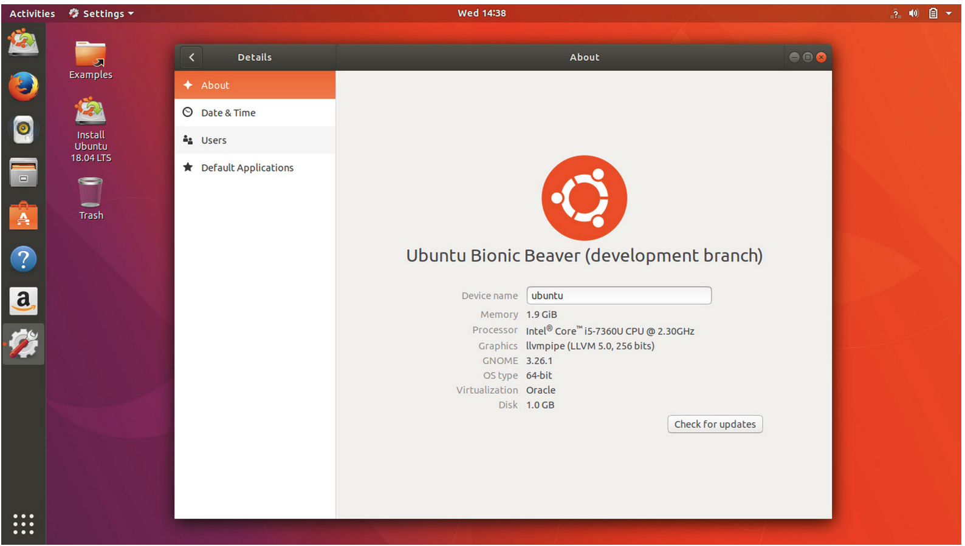
GUI – Graphical User Interface

Slide 13
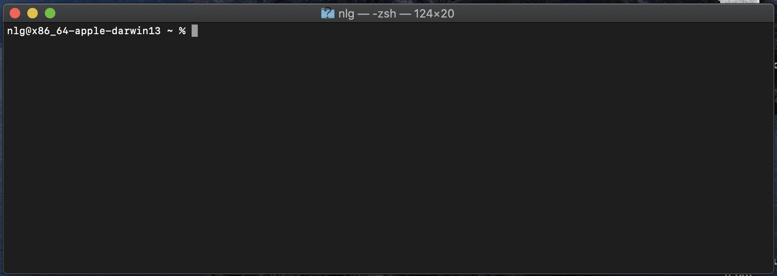
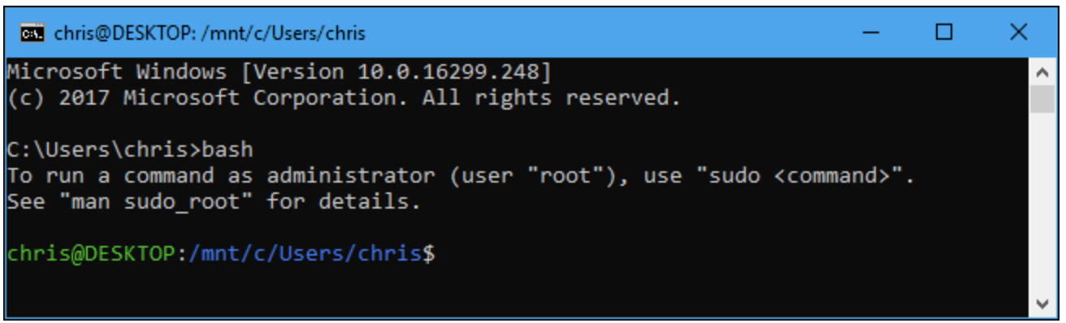
Shell (command line interface, CLI)

Slide 14
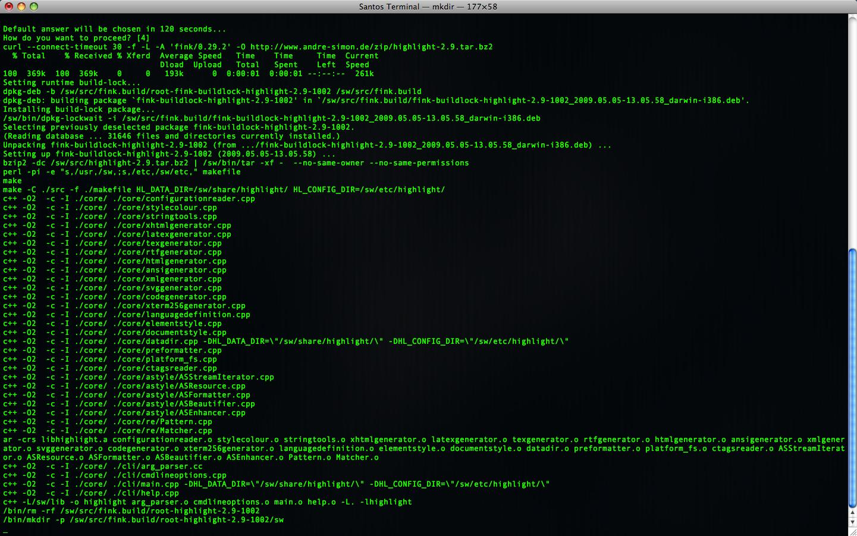
CLI – Command Line Interface

Slide 15
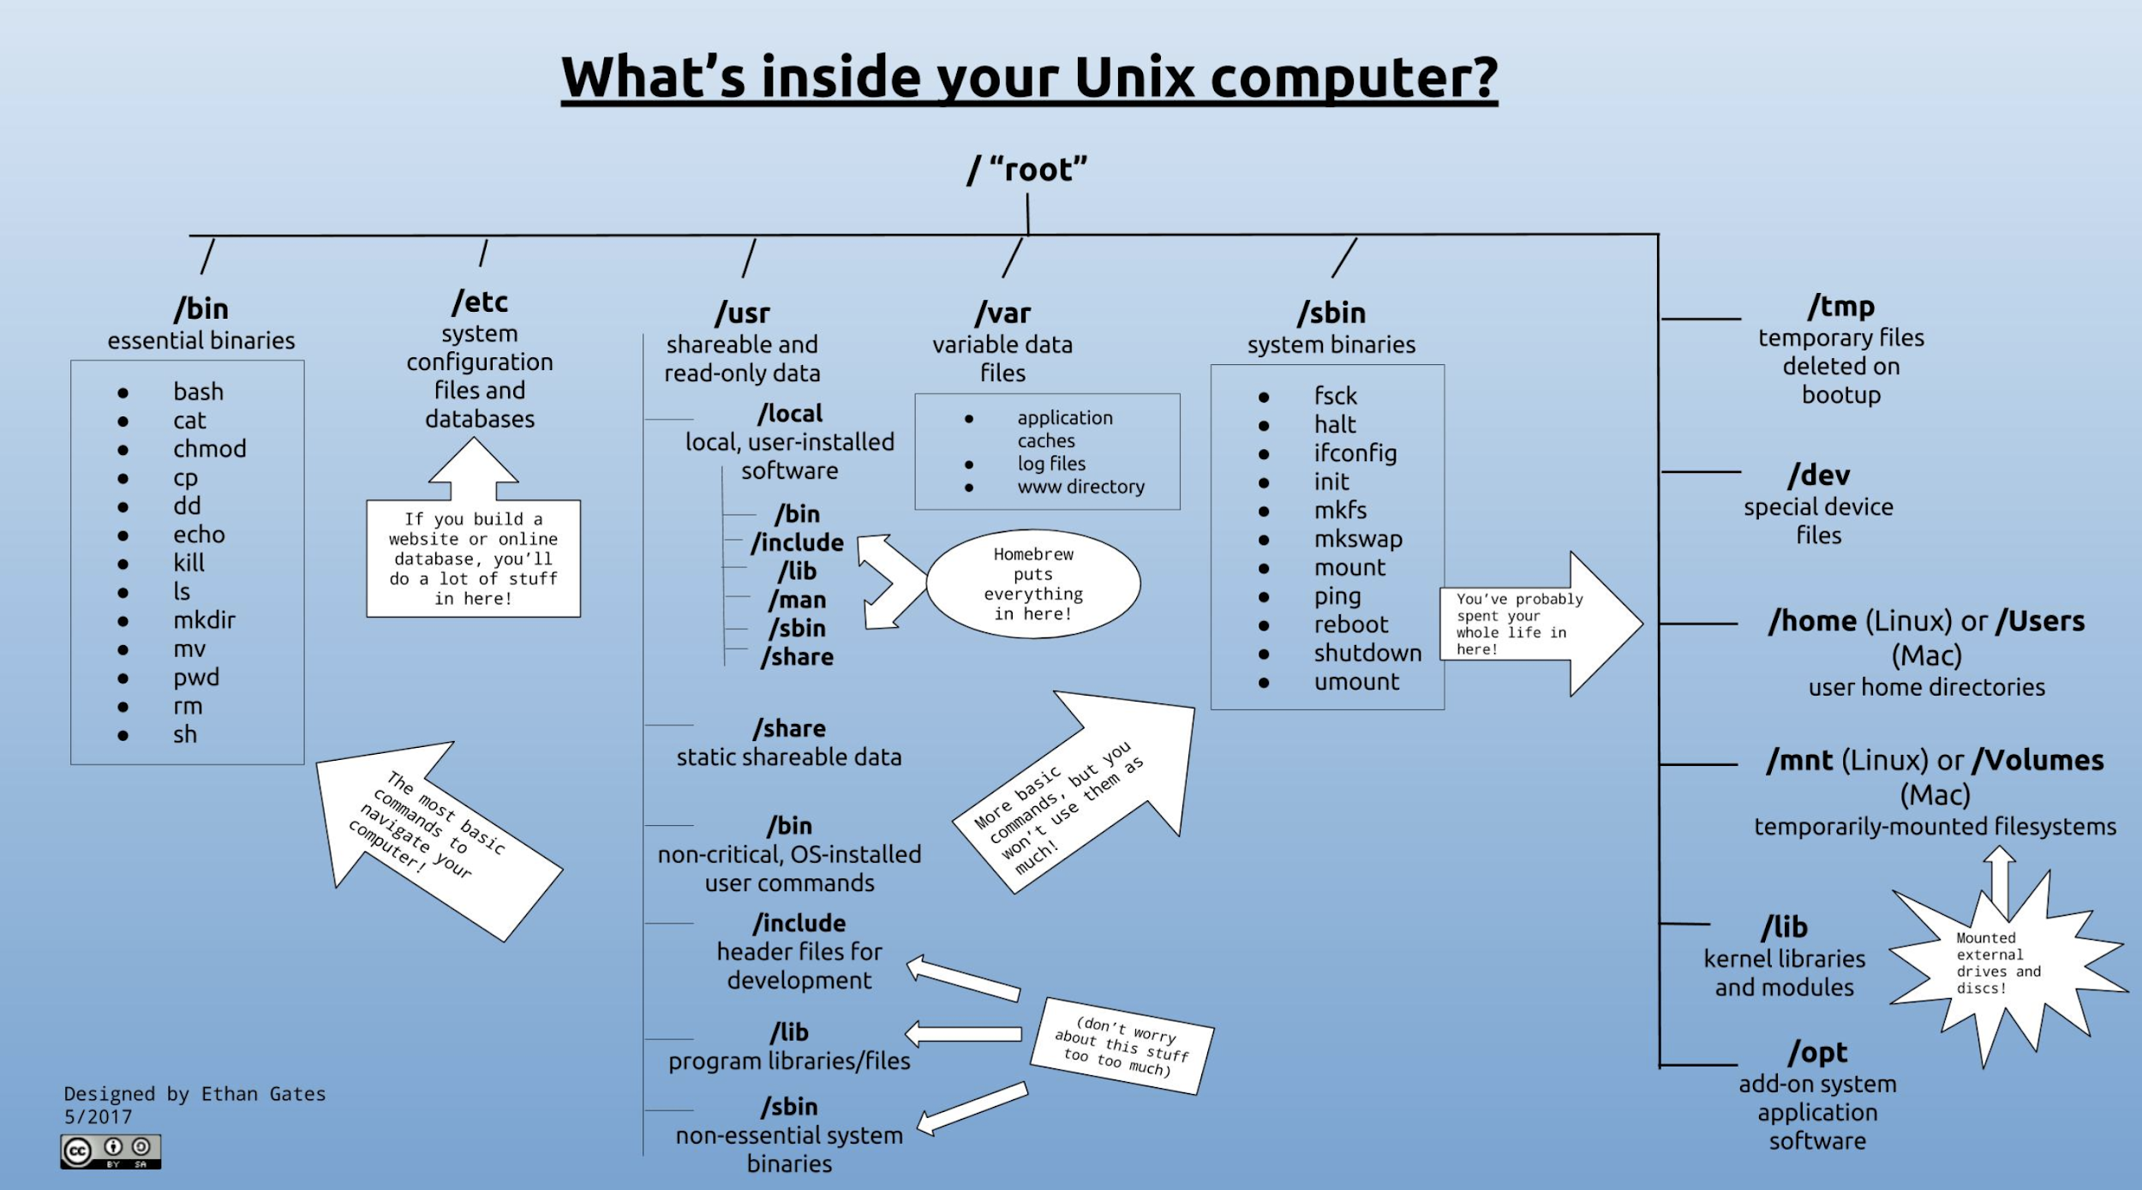
Filesystem
Notes:
cd
ls
pwd
paths
home directory
man
which

Slide 16
Why Do We Use Linux
Costless
Stable
Reliable
Extremely powerful
Highly Secure

Slide 17
Trade-offs
Weaknesses
Command line shell is “hostile”
Need to understand main design features
Richness of utilities
Does EXACTLY what you ask
Strengths
Full multitasking
Access controls and security
Richness of utilities
Everything is a file
Does EXACTLY what you ask

Slide 18
Uses of Linux
DoD, education, banking, government agencies, all of your devices…Android,IOS, routers, air traffic control, smart appliances, game design
supercomputing

Slide 19
HPC = high performance computing
Often in bioinformatics we deal with very large amounts of data
Need lots of computing power and the ability to run processes in parallel
splitting a job up over many compute nodes vs sequentially hitting the same node
Desktop computers are not capable of handling large bioinformatic datasets or would take too long at full capacity to complete a job
Supercomputers can complete tasks in a fraction of the time it would take to do the same thing on your laptop…

Slide 20
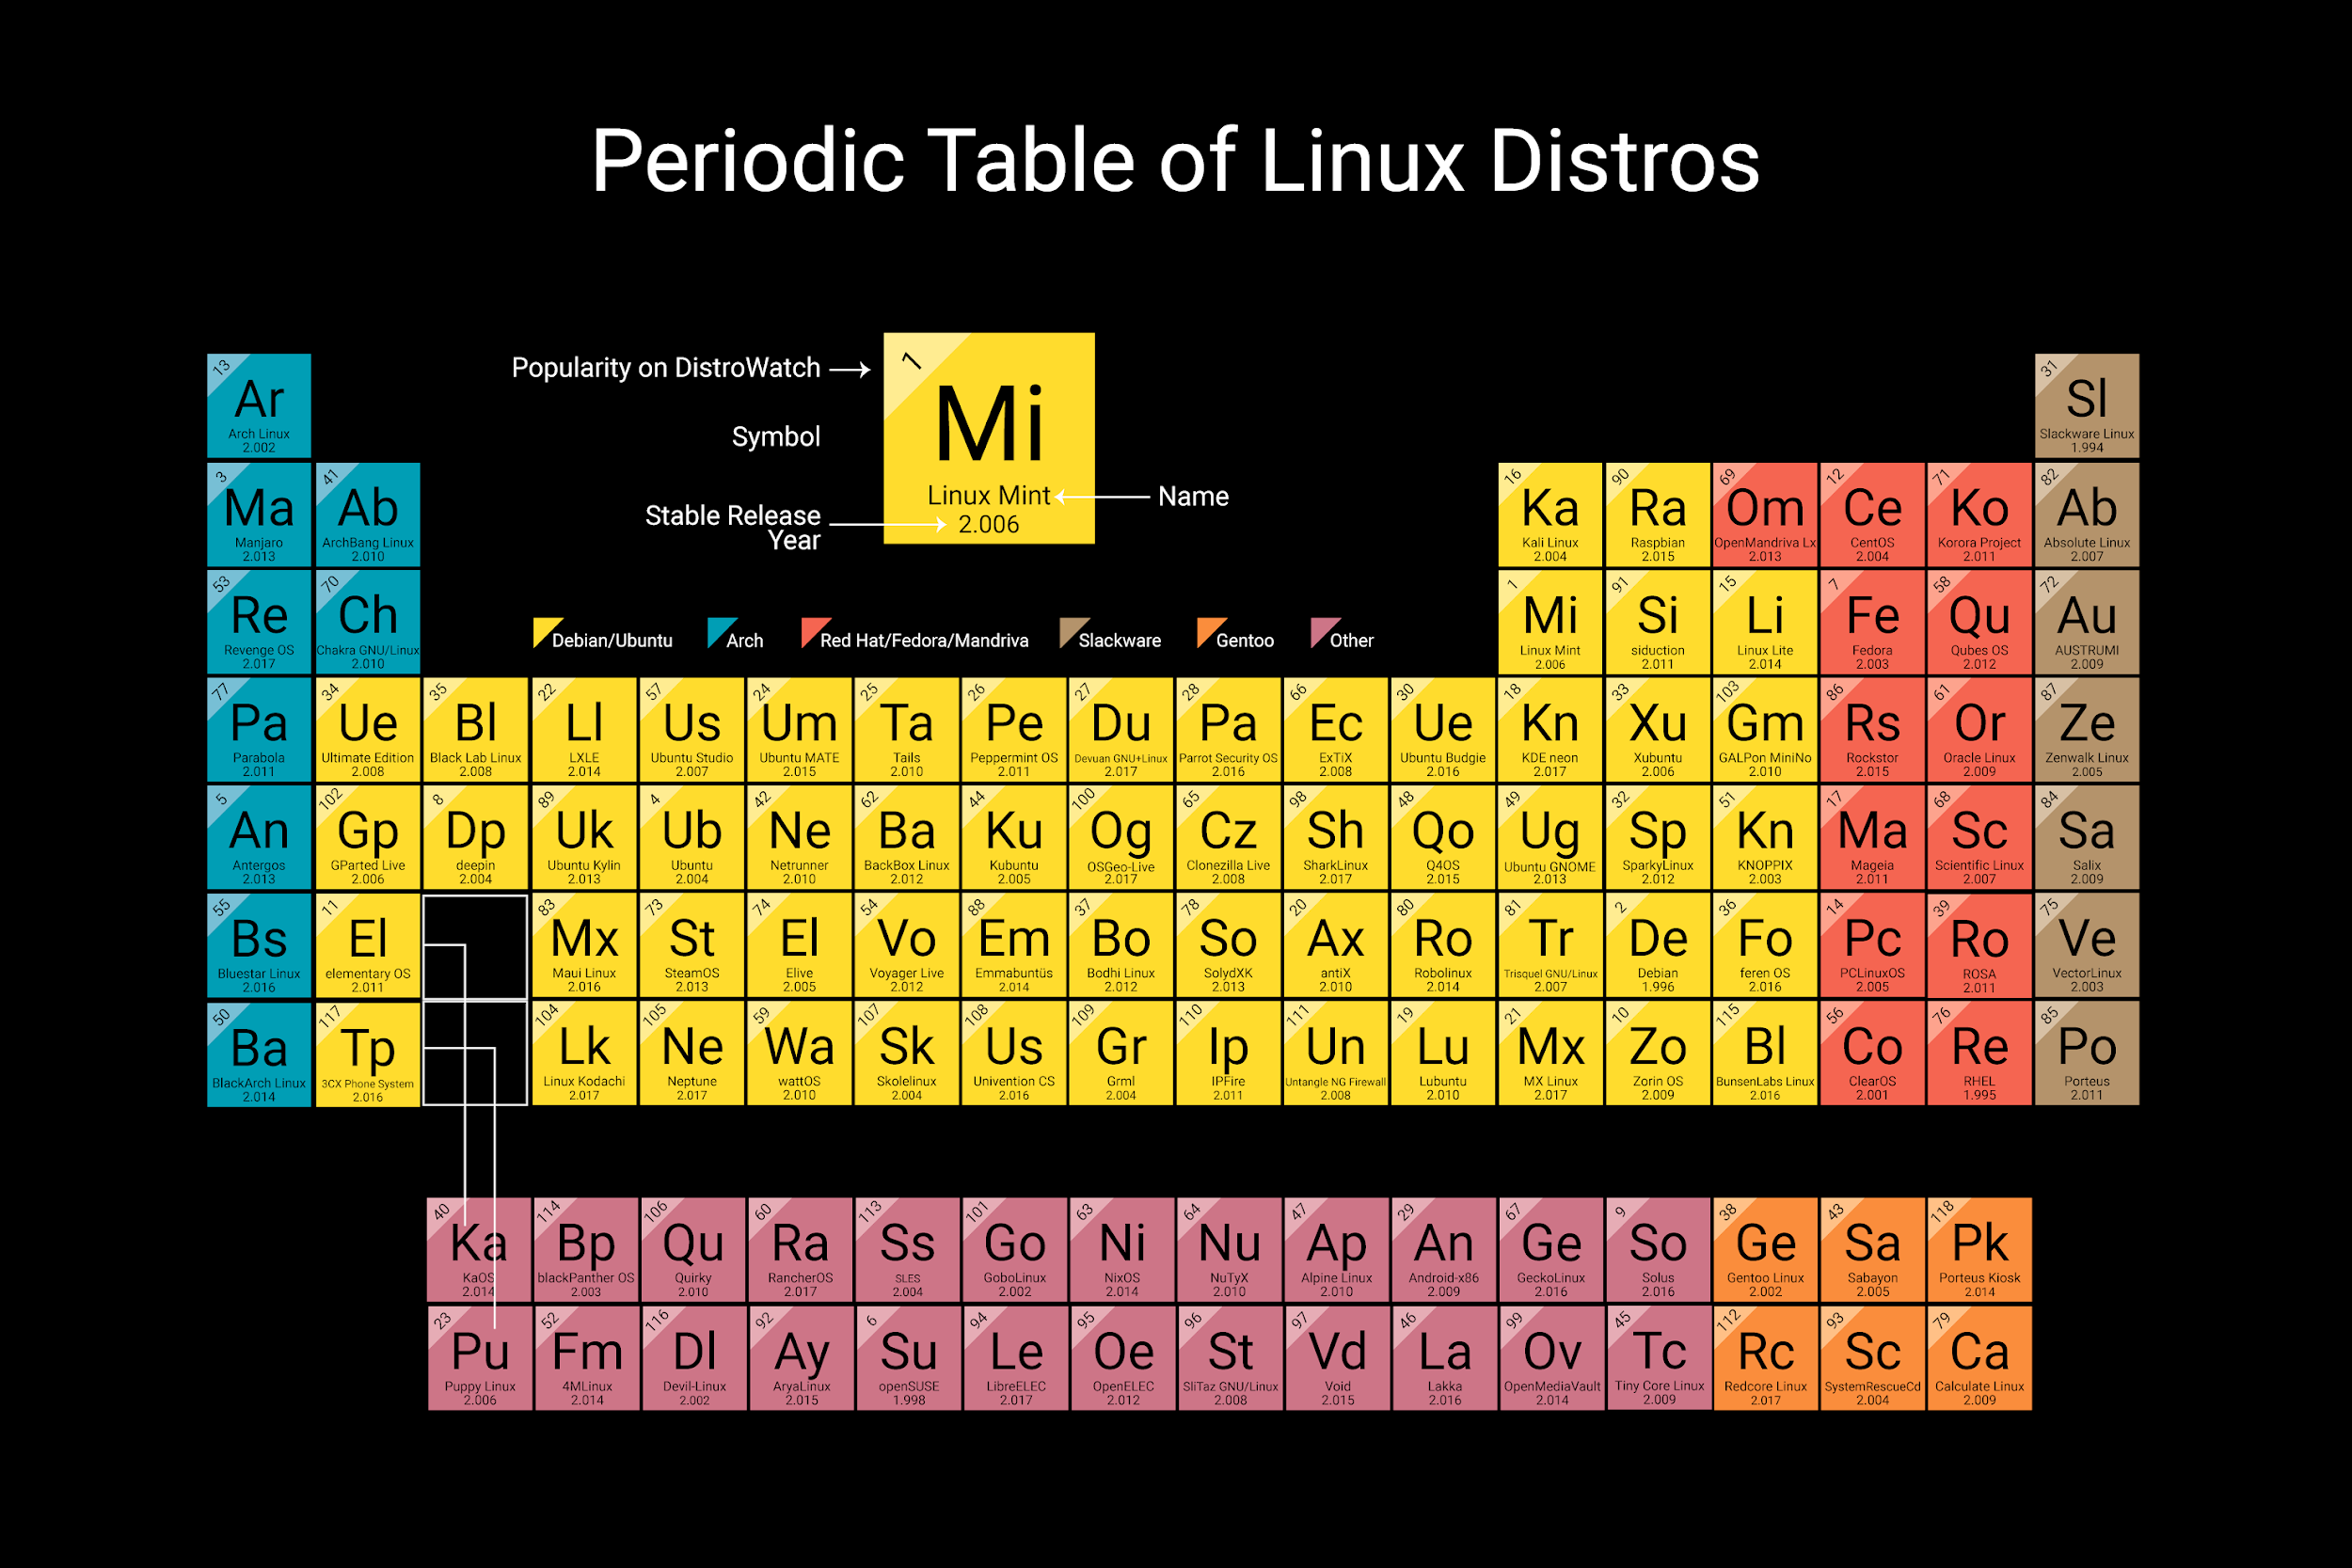

Slide 21





Ways to Get Linux
Full download, overwrite your existing OS
Partition
Virtual Machine
bootable USB
Google Cloud

Slide 22
Role of LINUX in our bootcamp
Server we connect to runs Ubuntu Server
To properly interface with a remote linux machine we must use a terminal on our local machines
Files can be uploaded/downloaded via command line (scp), using a file transfer program (like Cyberduck), or by accessing a shared network drive from your computer

Slide 23
Practice logging into server…
$ ssh username@10.217.2.5
$ = command prompt
= single space
text = things you should type

